Slide 1
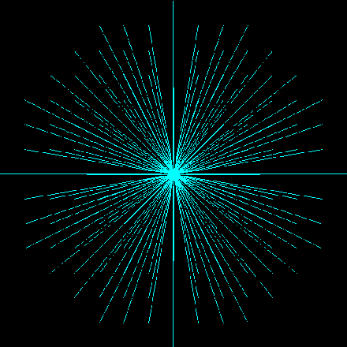
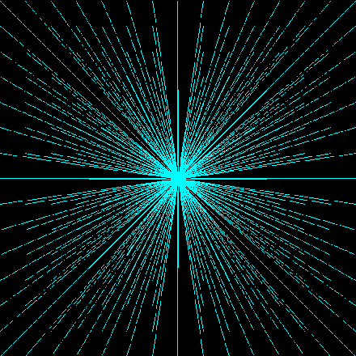
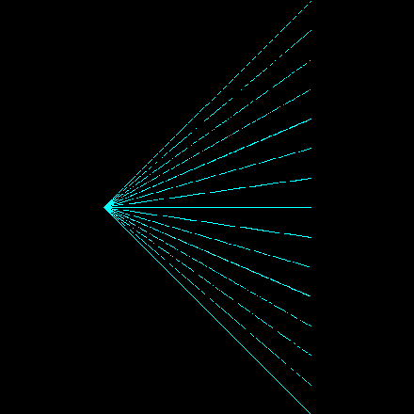
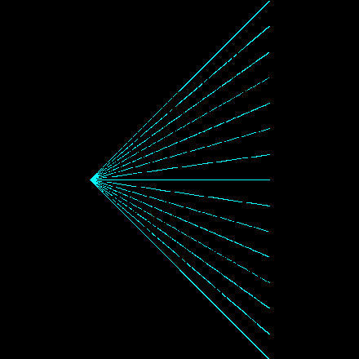
Ray bundle patterns
Front Views
Side Views
Cylindrical Spiral of Rays
Cylindrical Grid of Rays (Thick Ray Sampling)
Concentric Cone of Divergent Rays
Grid of Divergent Rays (Perspective View Frustum)
Simple Grid of Parallel Rays (Orthogonal View)

