Slide 1
Title- BRL-CAD
Text- example: BRL-CAD Is a open source software witch allows people to edit. Created by Mike Muuss who went to John Hopkins University.

Slide 2
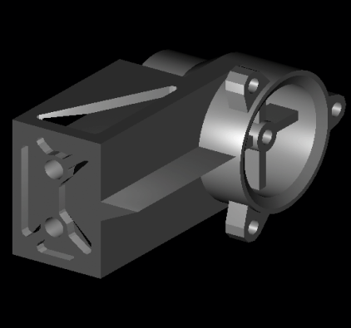
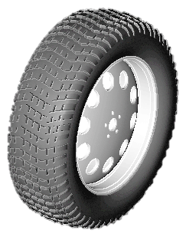
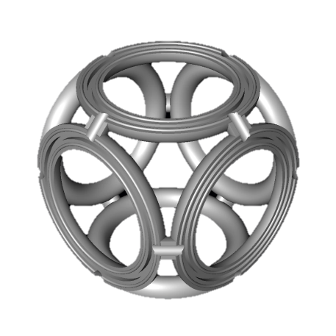
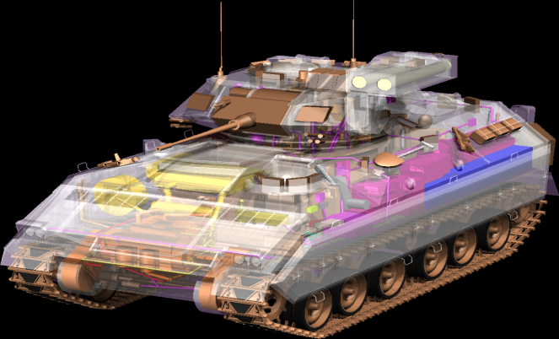
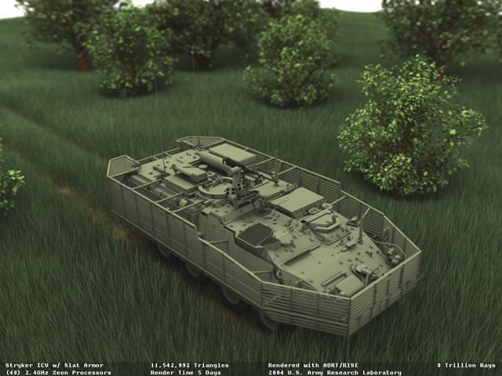
What is it?
BRL-CAD is used like a facebook for people where they can publish their projects or applications and let other people edit it. Its allows people to correct each other faults and use peoples different skills to help allow the project or application become the best it can be.

Slide 3
How is it used?
When people want something to be shared they log on and then upload to the BRL-CAD website.
People who are keen to help others can log on as well and they can download the file and edit it with a record they download it.
They then upload it and the owner of the file then need to review it and verify otherwise they editor may damage the file
The file has been improved and the more people use their skills to improve the file the better

